Slide 1
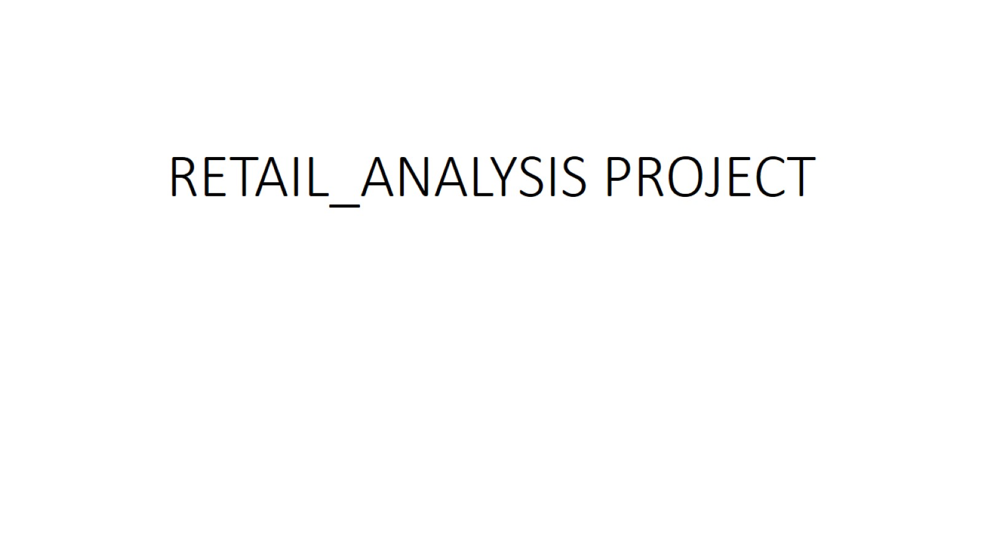
RETAIL_ANALYSIS PROJECT

Slide 2
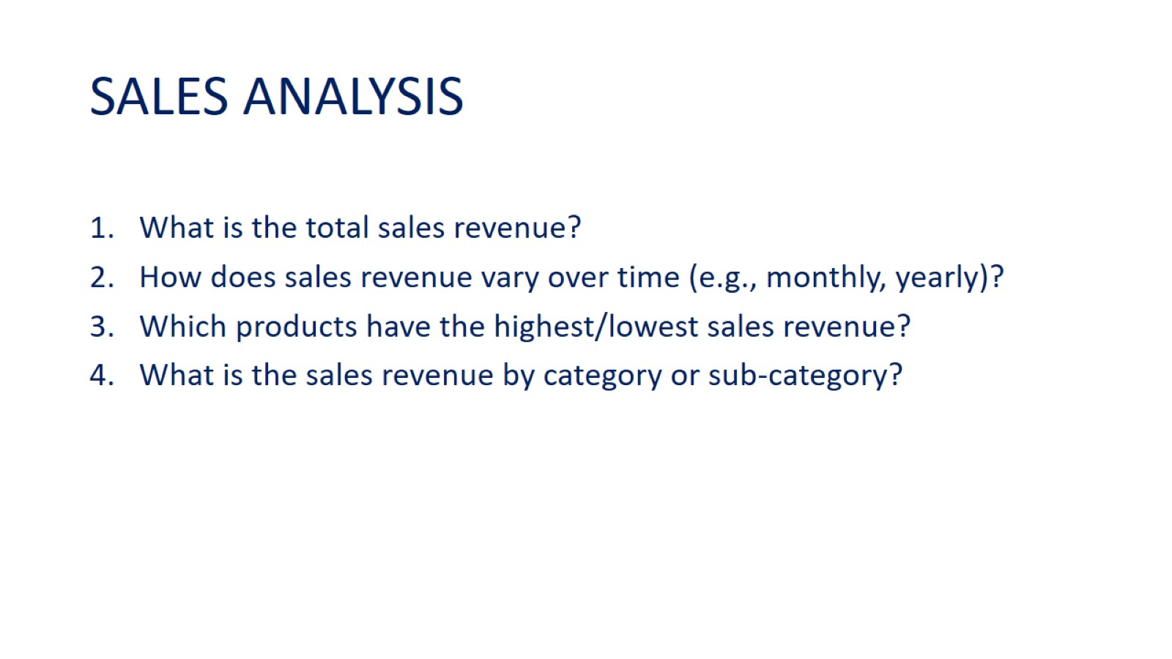
SALES ANALYSIS

Slide 3
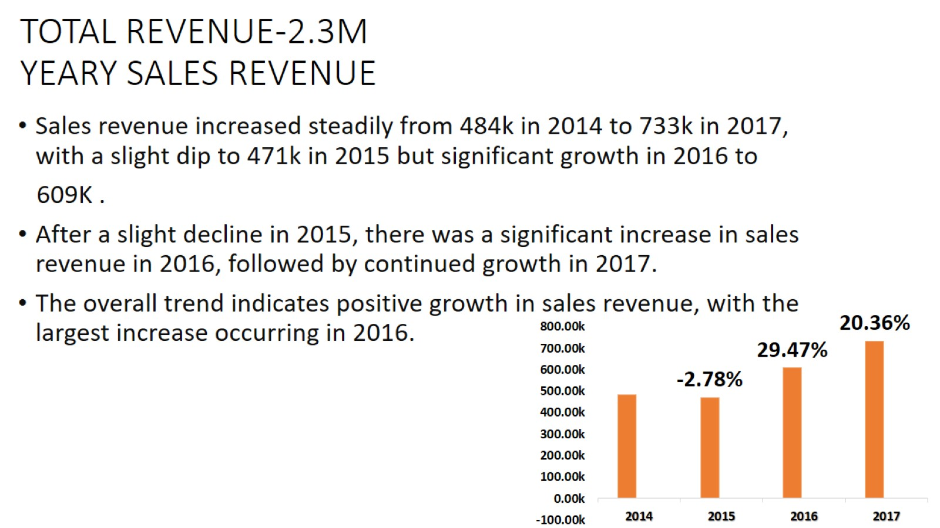
TOTAL REVENUE-2.3M YEARY SALES REVENUE

Slide 4
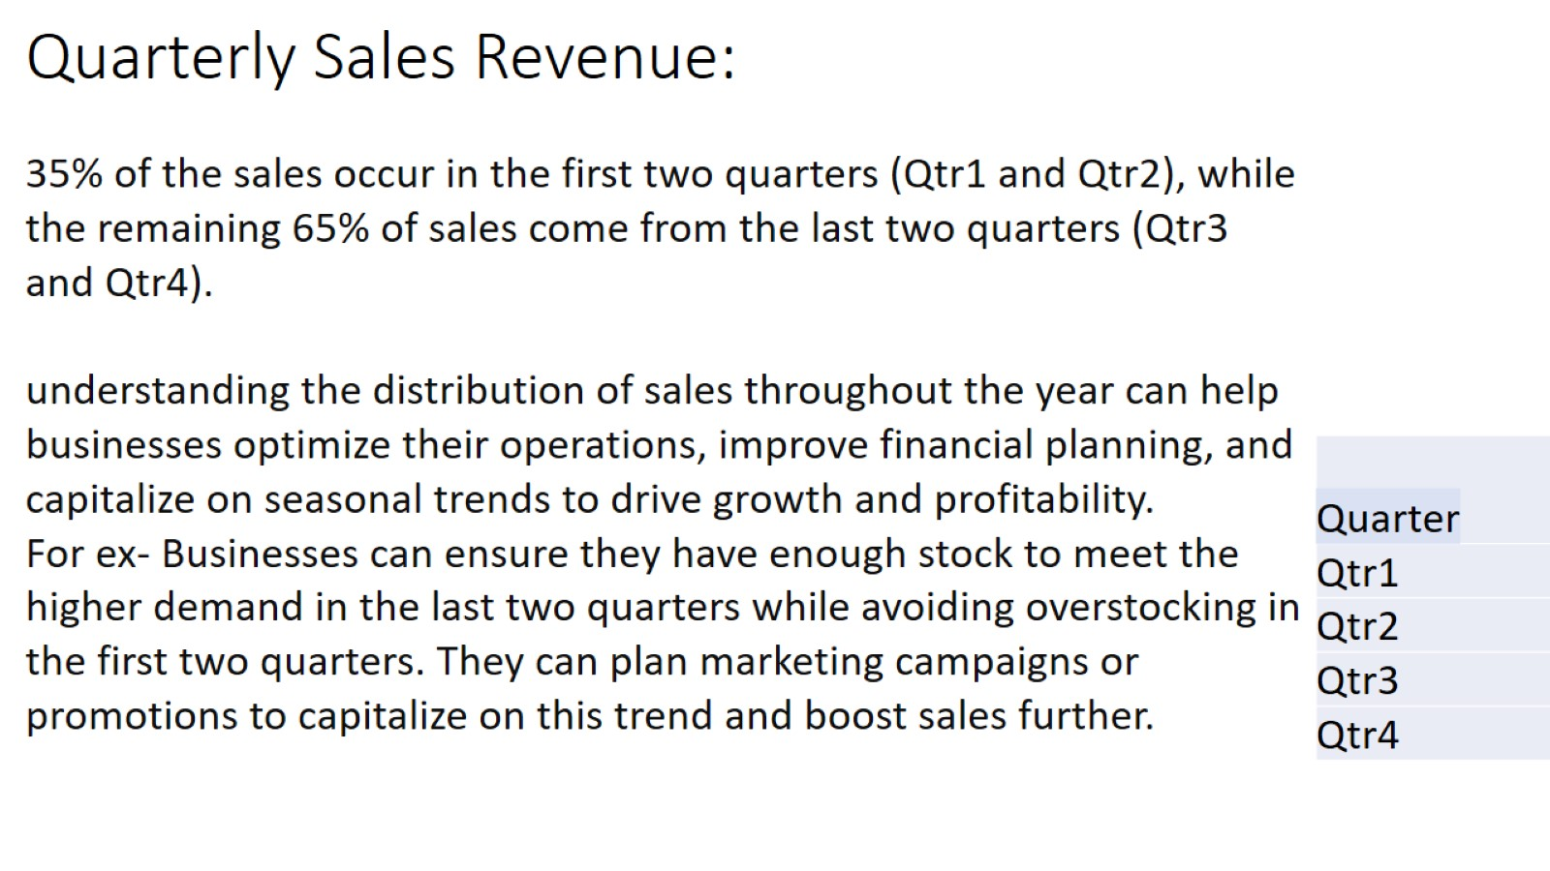
Quarterly Sales Revenue:

Slide 5
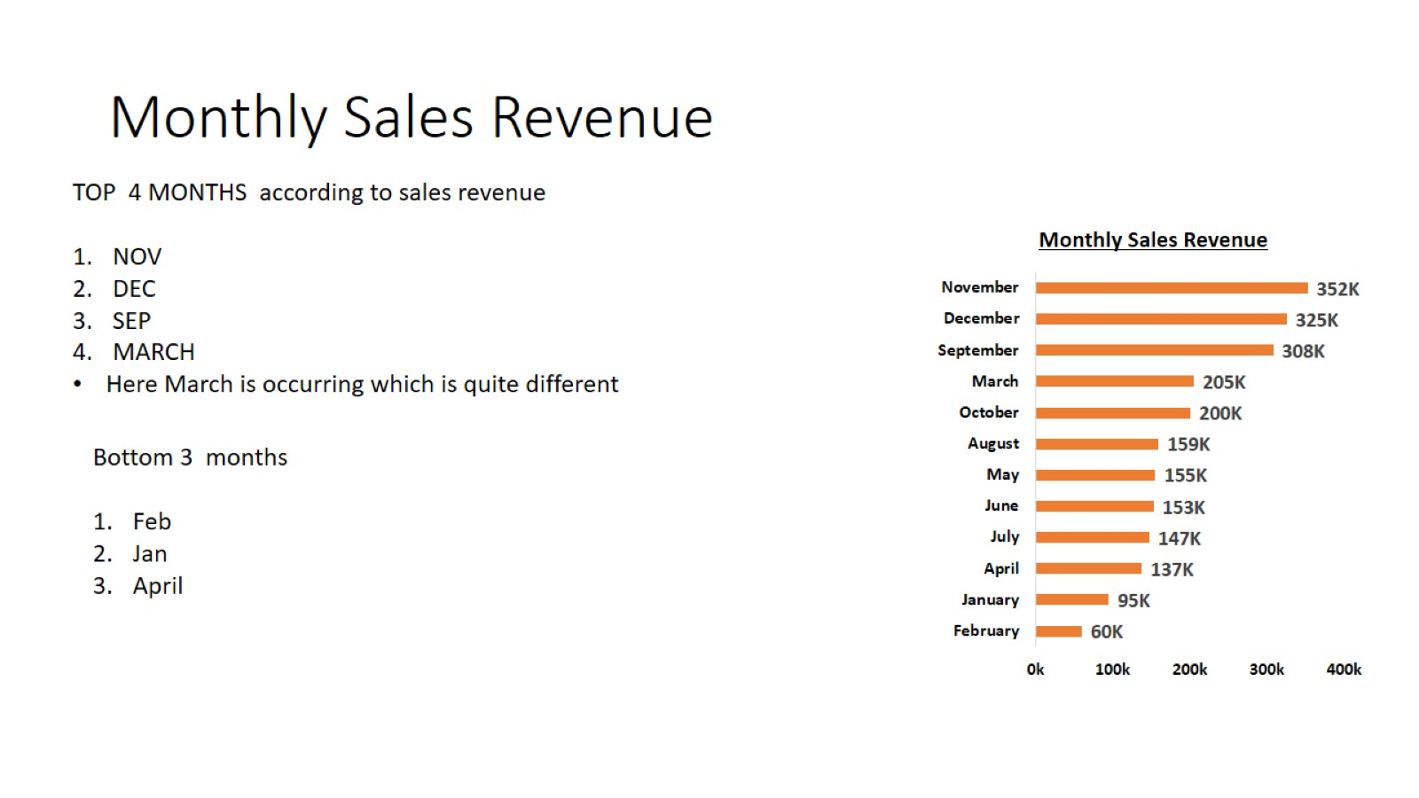
Monthly Sales Revenue

Slide 6
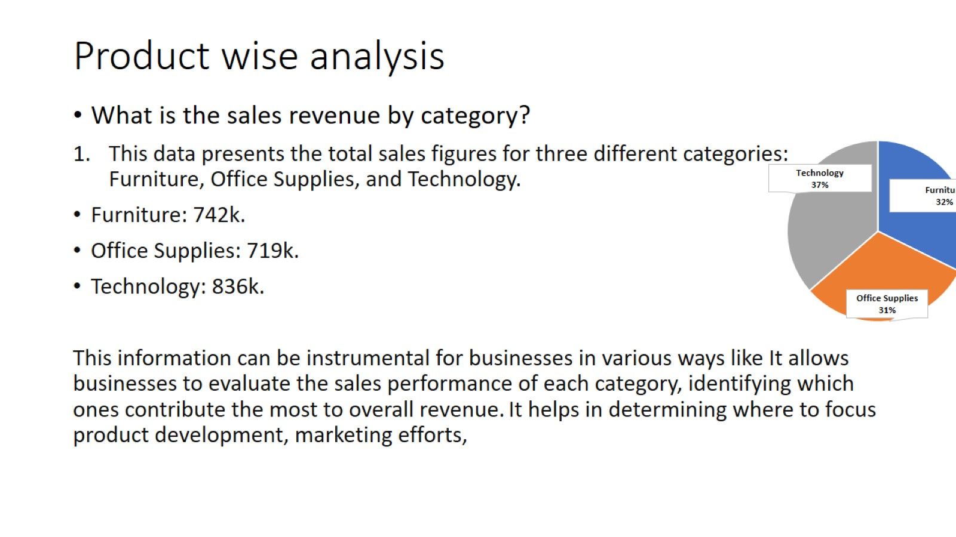
Product wise analysis

Slide 7
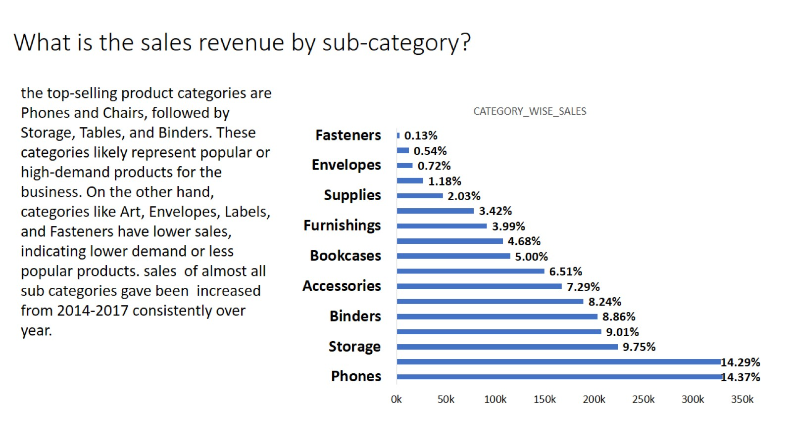
What is the sales revenue by sub-category?

Slide 8
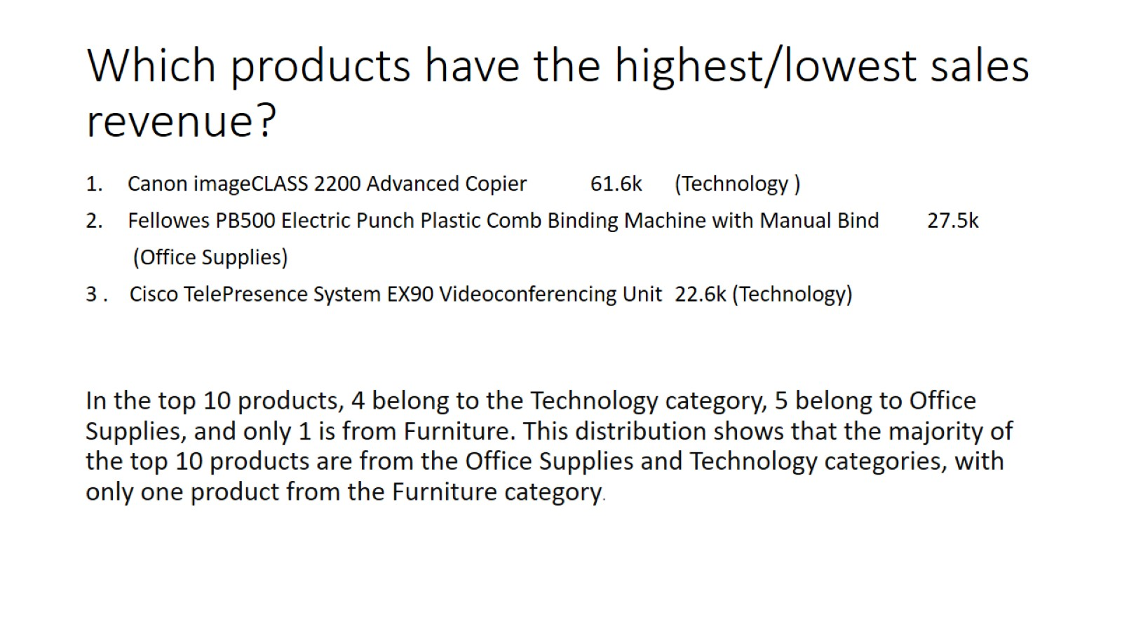
Which products have the highest/lowest sales revenue?

Slide 9
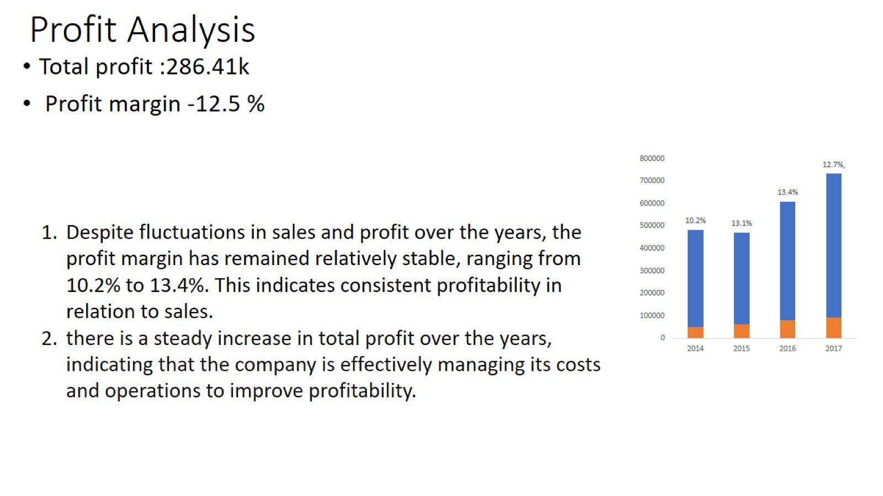
Profit Analysis

Slide 10
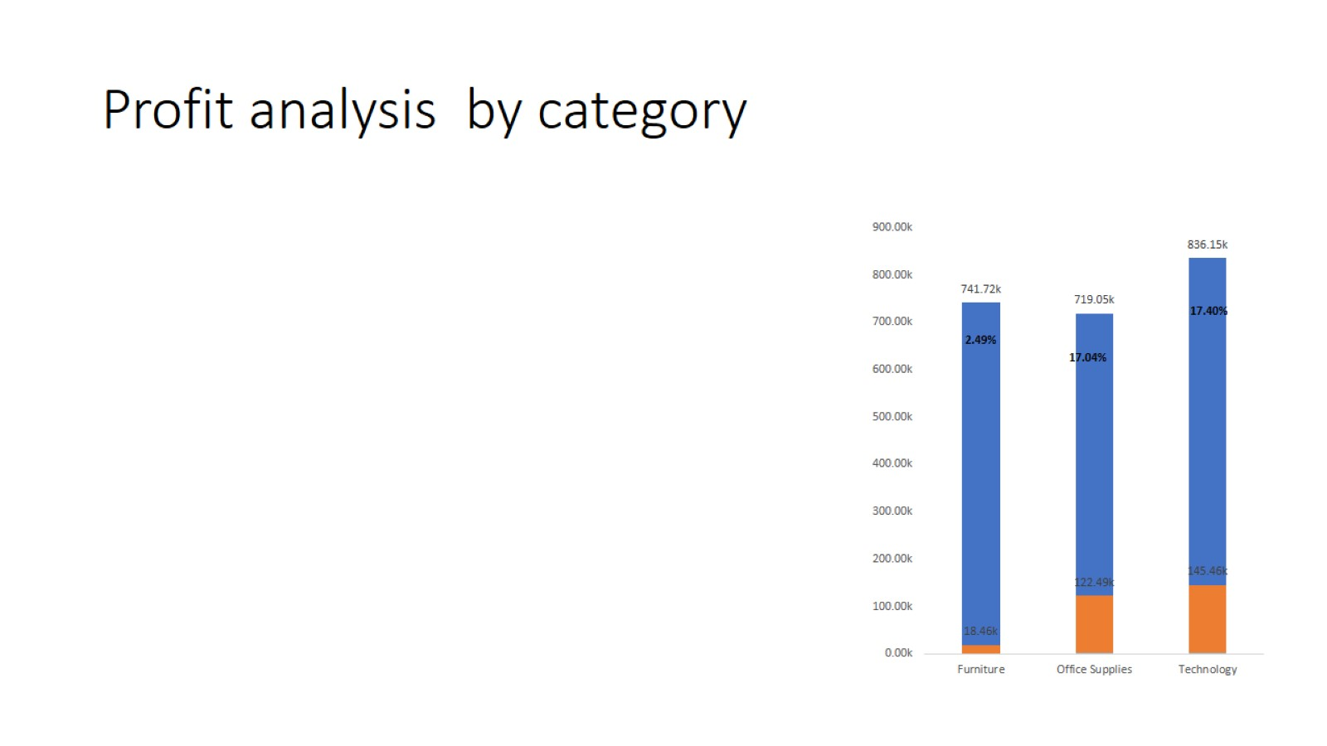
Profit analysis by category

Slide 11
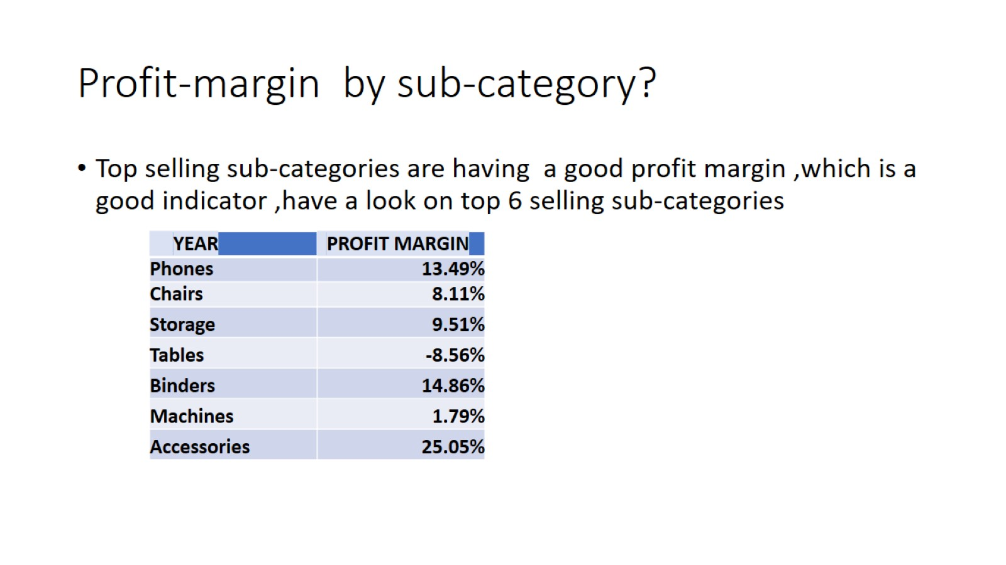
Profit-margin by sub-category?

Slide 12
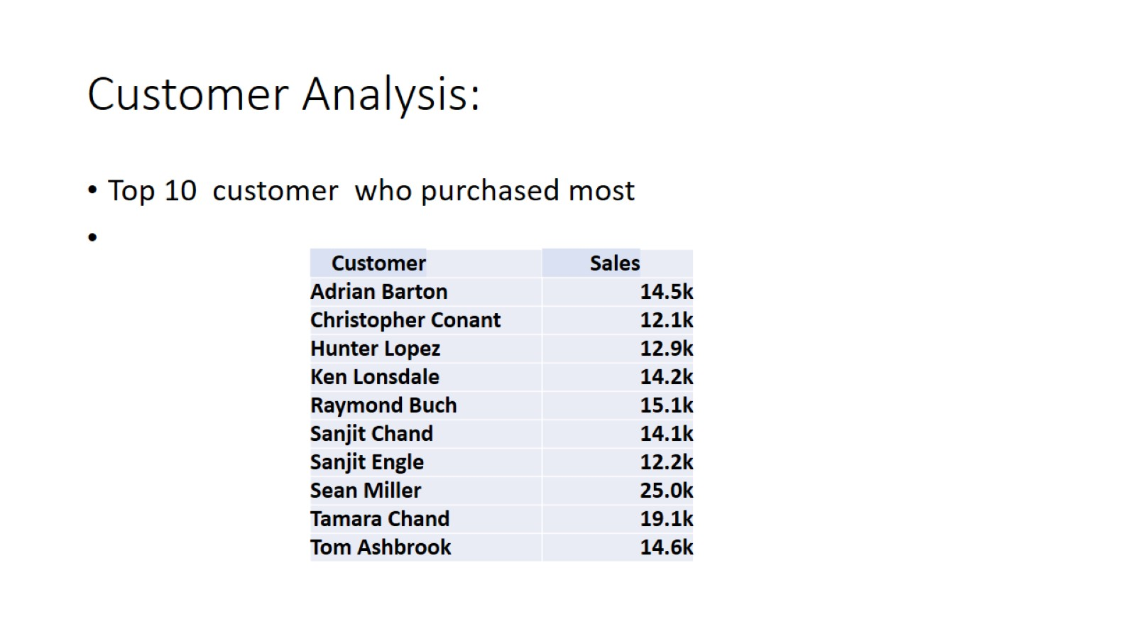
Customer Analysis:

Slide 13
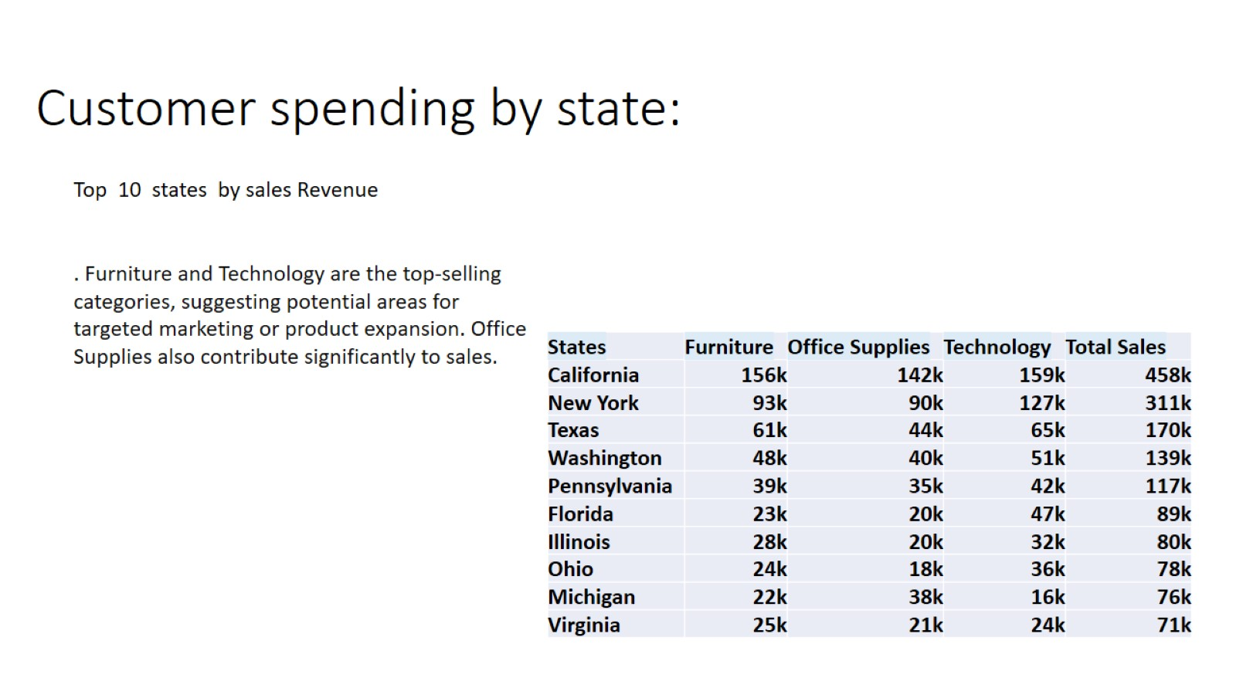
Customer spending by state:

Slide 14
why I derived these specific insights
Here is some theory behind it which I mostly asked to ChatGPT .have a look in upcoming slides.

Slide 15
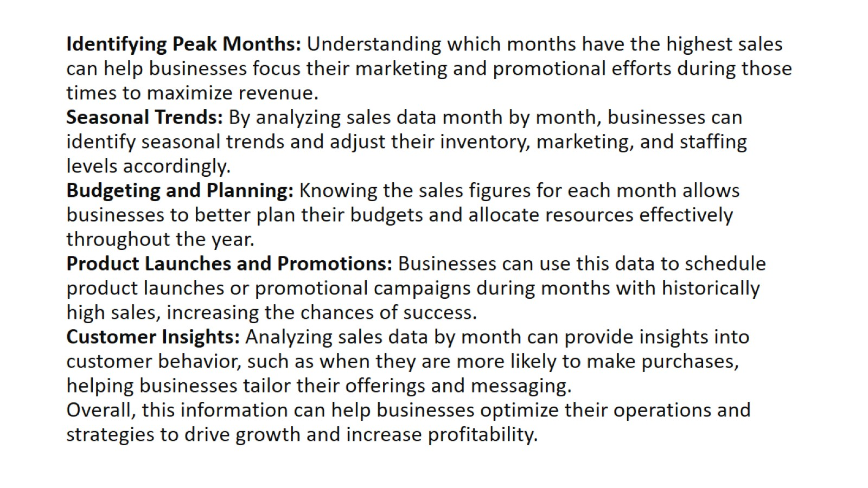
Identifying Peak Months: Understanding which months have the highest sales can help businesses focus their marketing and promotional efforts during those times to maximize revenue. Seasonal Trends: By analyzing sales data month by month, businesses can identify seasonal trends and adjust their inventory, marketing, and staffing levels accordingly. Budgeting and Planning: Knowing the sales figures for each month allows businesses to better plan their budgets and allocate resources effectively throughout the year. Product Launches and Promotions: Businesses can use this data to schedule product launches or promotional campaigns during months with historically high sales, increasing the chances of success. Customer Insights: Analyzing sales data by month can provide insights into customer behavior, such as when they are more likely to make purchases, helping businesses tailor their offerings and messaging. Overall, this information can help businesses optimize their operations and strategies to drive growth and increase profitability.
Benefits of analysing sales trends

Slide 16
